Slide 1
Implementation and comparison of TRNG designs on FPGA
Abhijith Kashyap
Srihari Sankar

Slide 2
Overview
True Random Number Generators use natural phenomenon to generate random bit streams
Unlike Pseudo RNG which follow an algorithmic approach
2 TRNG designs are implemented on FPGA -
FIGARO TRNG
Metastability TRNG
Performance evaluated using NIST Statistical Test Suite
Area and implementation complexity discussed

Slide 3
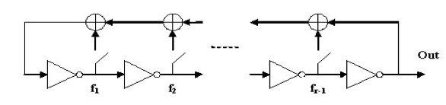
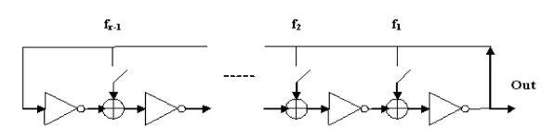
FIGARO TRNG
Particular design proposed by Golic et. al.
FIbonacci-GAlois-Ring-Oscillator TRNG
Uses Fibonacci and Galois LFSR like structures with DFF replaced by inverters
Has more entropy than typical ring oscillator of just inverters
Fibonacci RO on the left and Galois RO on the right

Slide 4
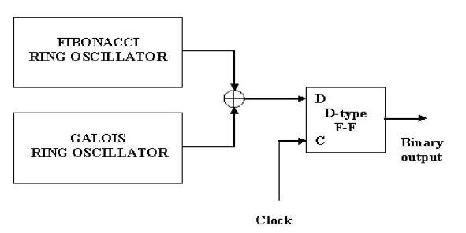
FIGARO TRNG
FIRO + GARO are free running oscillators
XOR of the 2 ROs sampled by a slower system clock
Their phase information wrt system clock is the source of randomness

Slide 5
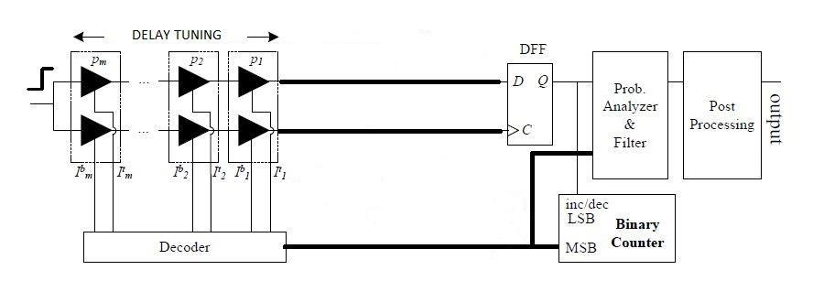
Metastability TRNG
Particular design proposed by Majzoobi et. al.
Get a flop in the metastable region (setup-hold window)
Ensure both clock and data of DFF are driven by same net
Add configurable delay lines on paths to compensate for path variations

Slide 6
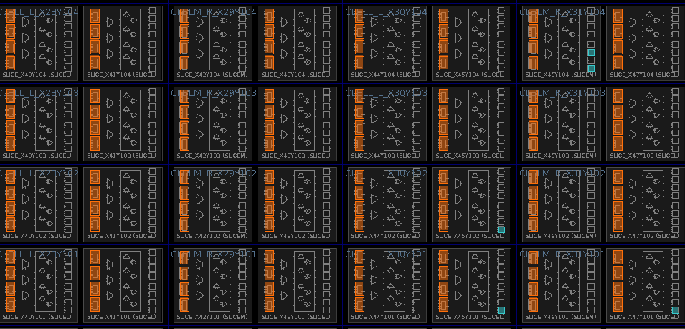
Metastability TRNG
Requires manual place and route of delay lines and sampling DFF as shown below
Design is not easily portable across different FPGAs

Slide 7
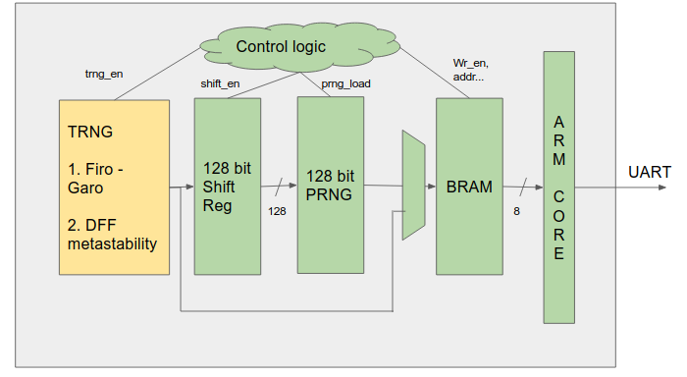
FPGA System
Implemented on Xilinx Zynq Zedboard
Logged data out through UART

Slide 8
Comparison
Design | NIST Performance | Area | Implementation Complexity
FIGARO | Good | High | Low
Metastability | Average | Low | Very High
Overall, FIGARO performs much better with quality of random data while requiring less effort to implement on FPGAs
Metastability based TRNG fails some NIST tests and requires significantly more effort on FPGAs

